Slide 1
JavaScript
Review
A summary presentation of whitehatJr class 1-42

Slide 2
TABLE OF CONTENTS
01
02
03
Number and strings
Variables
Arithmetic
Operations
04
05
06
Booleans
Conditional programming
Other Data types

Slide 3
TABLE OF CONTENTS
07
08
09
Loops
Arrays
Functions
10
Objects

Slide 4

INTRODUCTION
What is JavaScript ?
► JavaScript is a text-based programming language used both on the client-side and server-side that allows you to make web pages interactive.

Slide 5
01
Numbers and strings

Slide 6
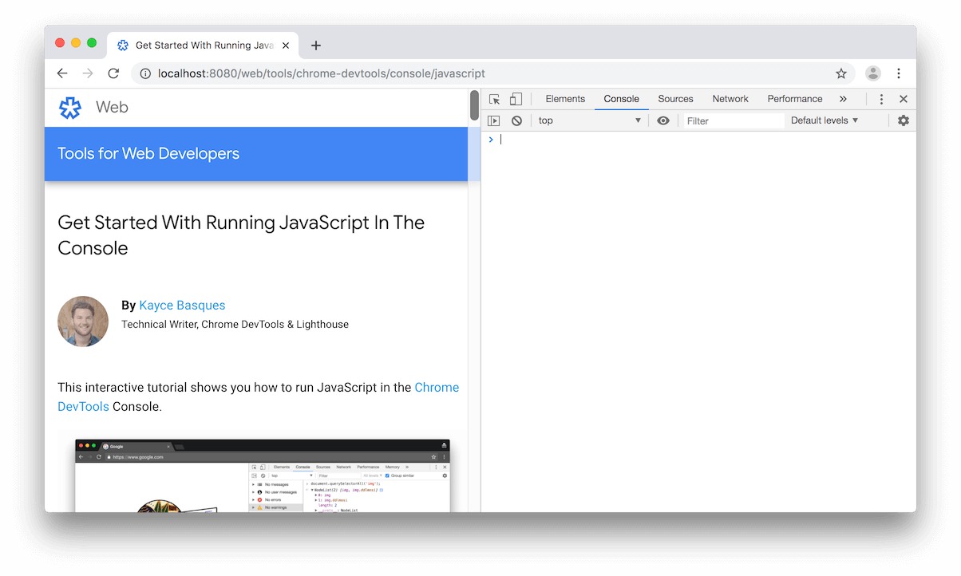
Using the console
1
2
3
4
“______”

Slide 7
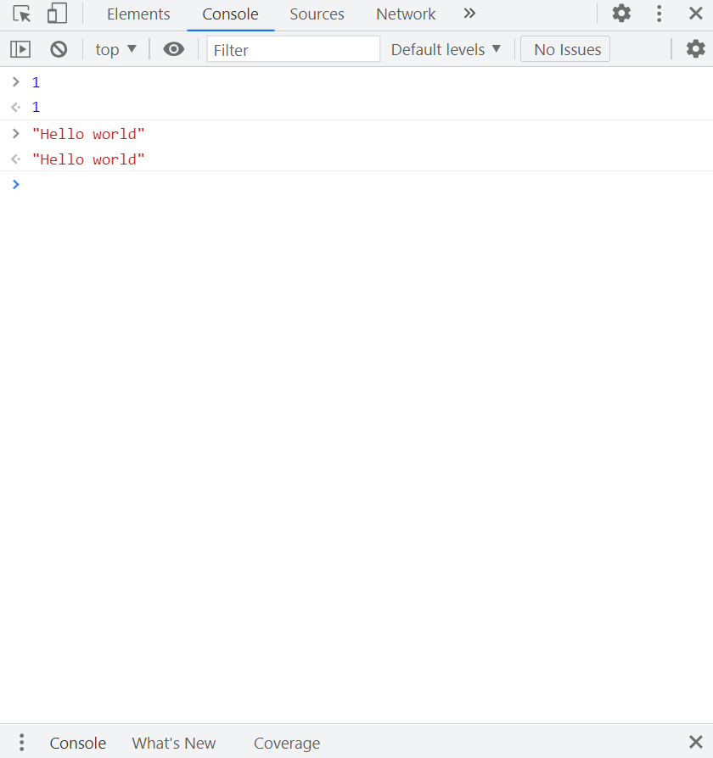
Trying entering strings and numbers in console
5
6
7
8
“______”

Slide 8
“This shows us that JavaScript can understand different kinds of data like numbers and string
Note: strings must be enclosed by quotes (“ ”)

Slide 9
02
variables

Slide 10
What is variable
Variable means anything that can vary. JavaScript includes variables which hold the data value and it can be changed anytime. JavaScript uses reserved keyword var to declare a variable. A variable must have a unique name

Slide 11
Using variable
var name = Mrudul
This means Mrudul is stored in a container called name
          1) Strings are objects in JavaScript and they have some
          properties and functions defined
variable.length
Will give you the length of data in variable
eg : name.length
= 6

Slide 12
Using variable
          Variable.toUpperCase()
          The data of variable turns in uppercase
                eg : name .toUpperCase()
                = MRUDUL
You can even store numbers in a variable
var num = 5

Slide 13
03
Arithmetic operation

Slide 14
The computer can understands Arithmetic
Operations
Division
Minus
Addition
Multiplication

Slide 15
Arithmetic Operations on numbers
Arithmetic
Operations on strings
2+3 = 5
2-3 = -1
5*7 = 35
12/6 = 2
12%5 = 2
1/0 = Infinity
"Hi" + “ Friend“
Hi Friend
"a" / "b"
NaN

Slide 16
04
Booleans
There is another Boolean data type in JavaScript which can hold only true or false
var Boolean = true
var Boolean = false

Slide 17
True
False

Slide 18
Comparison operators
>
<
<=
>=
!==
===

Slide 19
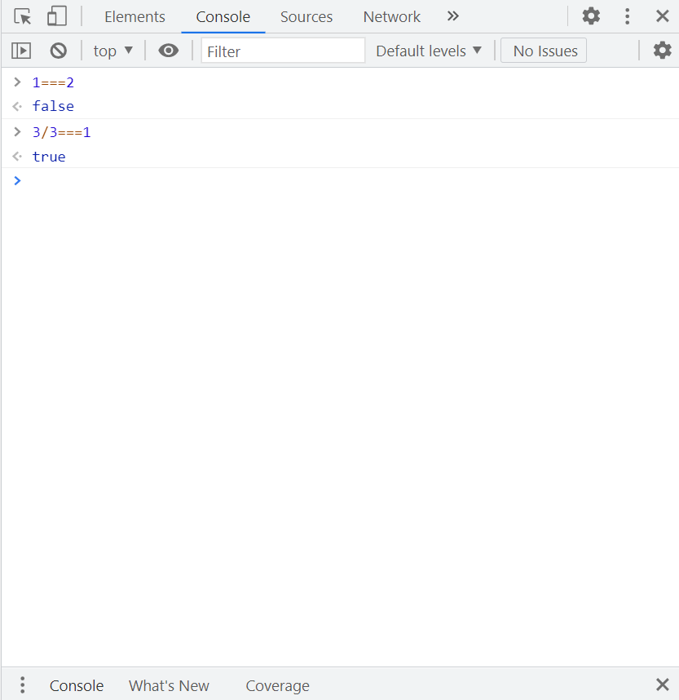
Trying Booleans in console

Slide 20
05
Other data types

Slide 21
Null
Undefined
Null is used when you want a variable to hold nothing
undefined is the value inside a variable when you have forgot to assign anything to it.
var score = null
var test
Console.log(test)
Console : undefined

Slide 22
Data types
Text / String
Numbers
Boolean
Undefined
Null
Object

Slide 23
06
Conditional programming

Slide 24
If statement
We can use if block to create conditional programming.
if(12/2===6){
console.log(“You are right")
}
If 12/2 = 6 then the computer prints - You are right in the console

Slide 25
If else statement
We can use if else block to create conditional programming.
if(12/2===6){
console.log(“You are right")
} else {
console.log(“You are wrong")
}
If 12/2 = 6 then the computer prints - You are right in the console, if it is not right it prints you are wrong

Slide 26
Switch statement
Switch statement is another way in which we can do conditional programming.
var name =my name
switch(name) {
case My name:
console.log("Condition 1");
break;
case "my Name":
console.log("Condition 2");
break;
default:
console.log("None of the conditions are true");
}

Slide 27
07
loops

Slide 28
For loop
for(var i=0;i<=400;i=i+20){
line(200,i,200,i+10);
}
This creates a dotted line starting from 0 and ending at 400 of length 10

Slide 29
while loop
var i = 0
while (i<=5){
        console.log(i)
        i=i+1
}
Console : 0 1 2 3 4 5 6
It exectutes only while “i” is less than or equal to 5

Slide 30
08
Arrays

Slide 31
Arrays are a type of data structure where you can use single variable to store a list of items.
var friends = ["friend1","friend2","friend3"]
You can access any item in the list using indexes. Note: Counting starts from 0 on computers
friends[0]
Console : friend1

Slide 32
Arrays are also objects in javaScript. They have some properties and function defined.
friends.length
Console : 3
friends.push(“friend4”)
Now its, friends["friend1","friend2","friend3”,”friends4”]
friends.pop();
Now its, friends["friend1","friend2","friend3”]

Slide 33
09
Functions

Slide 34
JavaScript has certain in-built functions which you can use. You can also write your own functions
function circumference(radius){
var circumference = 2 * 3.14 * radius
console.log(circumference)
}
circumference(5)
Console : 31.4159

Slide 35
10
Objects

Slide 36
We used classes to design blue prints of objects in javascript and then used new to create new object using the class.
Internally JavaScript creates a new object using new Object()
var paddle = new Object();
You can assign new properties and functions to test object.
paddle.length = 60
paddle.showLength = function(){
console.log(paddle.length);
}
paddle.showLength()
Console : 60

Slide 37
My profiles and games
https://mrudulkokala.whjr.site/
https://github.com/Mrudul23
https://editor.p5js.org/mrudulkokala25/sketches

Slide 38
Thank you

